Slide 1
Lecture 1: Combinatorics

Slide 2
The Sum Rule
If there are n(A) ways to do A and, distinct from them, n(B) ways to do B, then the number of ways to do A or B is n(A) + n(B).
Generalization:
There are n(A₁) + n(A₂) + … + n(A_{k}) ways to do A₁ , A₂ , … or A_{k} , the A_{i} s being all distinct.

Slide 3
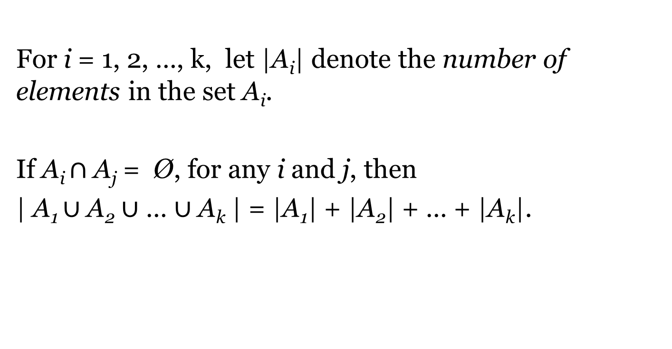
The Sum Rule Alternative Expression
For i = 1, 2, …, k, let |A_{i}| denote the number of elements in the set A_{i}.
If A_{i} $∩$ A_{j} = $\text{Ø}$, for any i and j, then
| A₁ $∪$ A₂ $∪$ … $∪$ A_{k} | = |A₁| + |A₂| + … + |A_{k}|.

Slide 4
The Product Rule
If there are n(A) ways to do A and n(B) ways to do B, then the number of ways to do A and B is n(A) × n(B).
This is true if the number of ways of doing A and B are independent; the number of choices for doing B is the same regardless of which choice you made for A.
Generalization:
There are n(A₁) × n(A₂) × …× n(A_{k}) ways to do A₁ , A₂ , … and A_{k} .

Slide 5
The Product Rule Alternative Expression
Let A × B denote the set of all ordered pairs (a, b), with a in A and b in B.
Then |A × B| = |A| × |B|.
Generally,
If A₁ × A₂ × … × A_{k} denotes the set of all ordered n-tuples (a₁, a₂, …, a_{k}), with a_{i} in A_{i}, then
| A₁ × A₂ × … × A_{k} | = |A₁| × |A₂| × … × |A_{k}|.

Slide 6
Problems
1. How many ways can 20 students choose to join 5 clubs, each student joining one club?
2. How many ways can 20 students choose to join 5 clubs, with no restrictions?

Slide 7
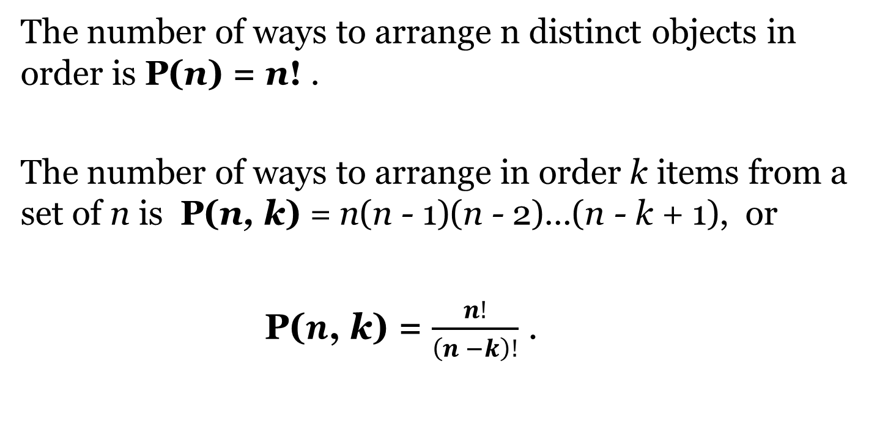
Permutation
The number of ways to arrange n distinct objects in order is P(n) = n! .
The number of ways to arrange in order k items from a set of n is P(n, k) = n(n - 1)(n - 2)…(n - k + 1), or
P($n\text{, }$k) = $\frac{n!}{\left(n −k\right)!}$ .

Slide 8
Problems
3. How many ways can 20 students sit in a row?
4. How many ways can an executive committee of 5 distinct posts be chosen from 20 students?

Slide 9

Combination
The number of ways to choose k items from a set of n is:
C($n\text{, }$k) = $\frac{n!}{\left(n −k\right)! k!}$ .

Slide 10
Problems
5. How many ways can a team of 5 be chosen from 20 students?
6. How many ways can 20 students be divided into 4 groups of 5?
7. How many ways can 20 students be divided into 4 groups, two having 5 members and the other two having 4 and 6 members respectively?

Slide 11
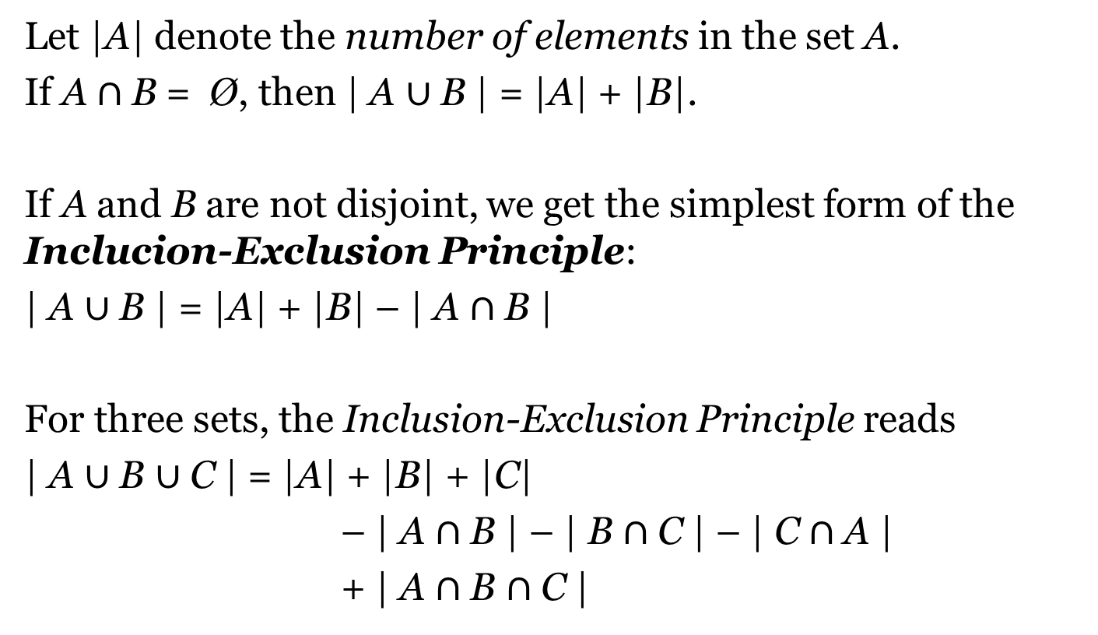
Inclusion-Exclusion Principle
Let |A| denote the number of elements in the set A.
If A$∩$B = $\text{Ø}$, then | A $∪$B | = |A| + |B|.
If A and B are not disjoint, we get the simplest form of the Inclucion-Exclusion Principle:
| A $∪$B | = |A| + |B| – | A $∩$B |
For three sets, the Inclusion-Exclusion Principle reads
| A $∪$B $∪$C | = |A| + |B| + |C|
– | A $∩$B | – | B $∩$C | – | C $∩$A |
+ | A $∩$B $∩$C |

Slide 12
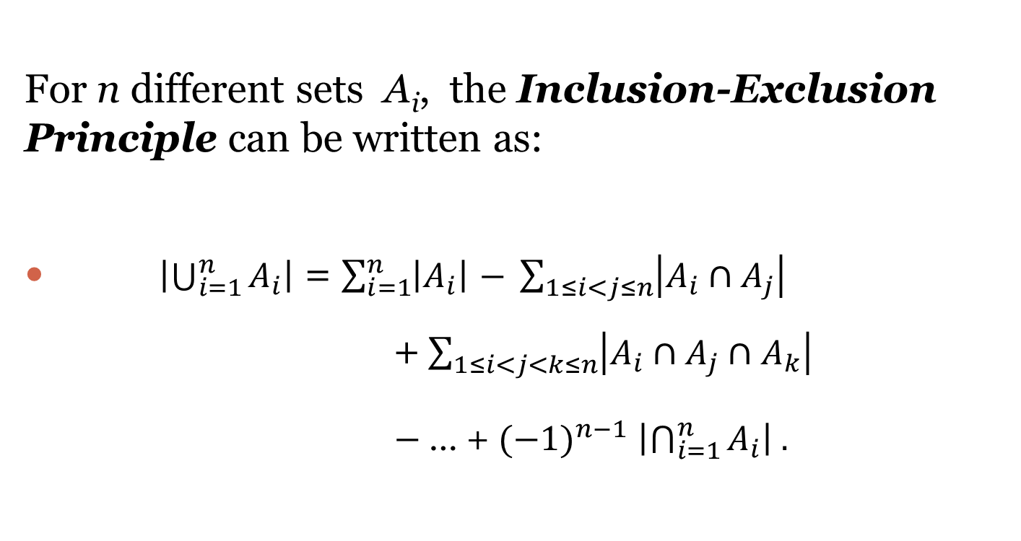
Inclusion-Exclusion Principle General Form
For n different sets A_{i}, the Inclusion-Exclusion Principle can be written as:
$\left|\bigcup_{i=1}^{n}{A_{i}}\right|$ = $\sum_{i=1}^{n}{\left|A_{i}\right|}$ $− \sum_{1≤i<j≤n}{\left|A_{i}∩A_{j}\right|}$ +$\sum_{1≤i<j<k≤n}{\left|A_{i}∩A_{j}∩A_{k}\right|}$
$−$ … + ${(−1)}^{n−1}$ $\left|\bigcap_{i=1}^{n}{A_{i}}\right| .$

Slide 13
Problems
8. How many ways can 20 students be divided into 5 groups of variable size?
9. How many ways can the exam scripts of 20 students be distributed among themselves, with at least one student getting his/her own script?
10. How many ways can the exam scripts of 20 students be distributed among themselves, so that no one gets his/her own script?

Slide 14
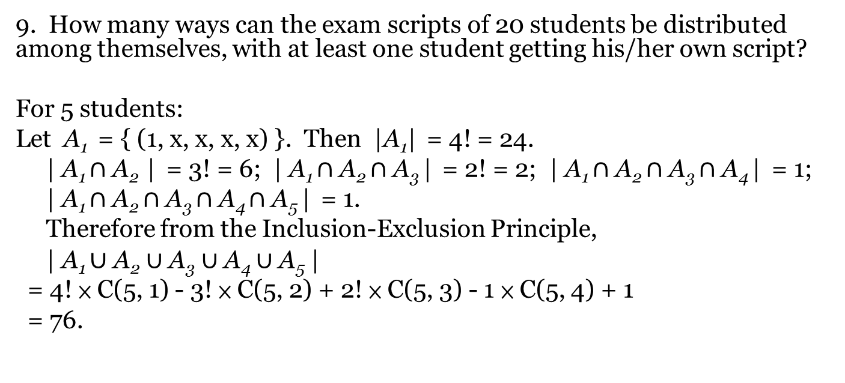
Problems (Hints)
9. How many ways can the exam scripts of 20 students be distributed among themselves, with at least one student getting his/her own script?
For 5 students:
Let A₁ = { (1, x, x, x, x) }. Then |A₁| = 4! = 24.
| A₁ $∩$ A₂ | = 3! = 6; | A₁ $∩$ A₂ $∩$ A₃ | = 2! = 2; | A₁ $∩$ A₂ $∩$ A₃ $∩$ A₄ | = 1;
| A₁ $∩$ A₂ $∩$ A₃ $∩$ A₄ $∩$ A₅ | = 1.
Therefore from the Inclusion-Exclusion Principle,
| A₁ $∪$ A₂ $∪$ A₃ $∪$ A₄ $∪$ A₅ |
= 4! × C(5, 1) - 3! × C(5, 2) + 2! × C(5, 3) - 1 × C(5, 4) + 1
= 76.

Slide 15
Problems (Hints)
10. How many ways can the exam scripts of 20 students be distributed among themselves, so that no one gets his/her own script?
F(n+1) = [ F(n) + F(n-1) ] × n
F(0) = 1, F(1) = 0
F(2) = [F(1) + F(0)] × 1 = 1
.....
F(5) = [F(4) + F(3)] × 4 = 44
F(6) = 265; F(7) = 1854; F(8) = 14833; F(9) = 133496;
F(10 = 1334961

